Slide 1
Civil War Propaganda
Primary Source Influence Analysis

Slide 2
How was Propaganda used to influence the US Civil War?
Was that a good or bad action for the people of Wisconsin?

Slide 3
What is Propaganda?

Slide 4
Propaganda in:
Times of Warfare
Times of Peace

Slide 5
INFLUENCE
means...

Slide 6
Influence:
positive
negative

Slide 7
Brainstorm: What might propaganda be used for during the U.S. Civil War?

Slide 8
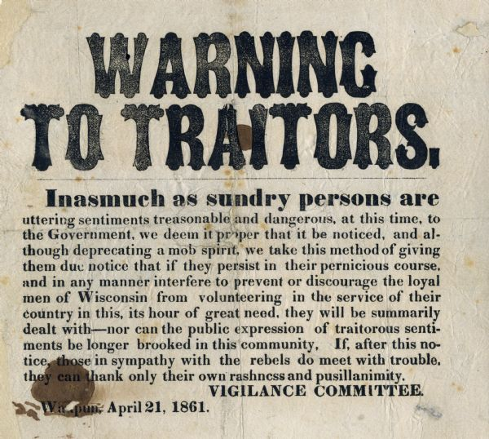
Primary Source Chart: Column 1

Slide 9
(Potential End to Day 1)
Or continue to Slide 11
Ticket out of the room:
Students a piece of paper write their thoughts about
How was propaganda used during the Civil War?
Use of Google Form:

Slide 10
Day 2
Propaganda is:
Influence means

Slide 11
Primary Source #1 review
Recap of Source #1

Slide 12
Source 2: OPTIONS
Teacher may select to have
ALL students use BOTH sources
Differentiated based on reading-comfort level
Emerging students-Photo and Caption
At grade level students-newspaper article
(2 paragraph section)
Advanced students-newspaper article
(entire article)
Sources that may help with background knowledge:
(Picture book about Old Abe)

Slide 13
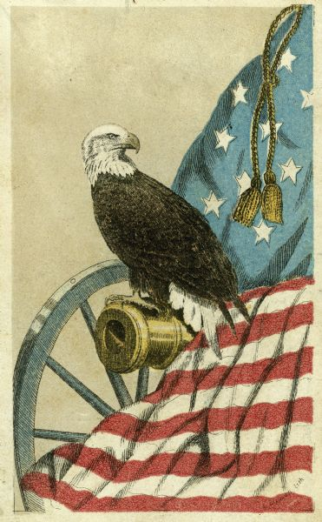
Primary Source #2: Old Abe Symbolism

Slide 14
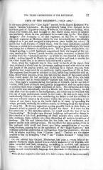
Primary Source Chart: Column 2
Potential Differentiation:
Emerging Students can use the enhanced photo and caption
At level Students: can read 2 paragraph section of newspaper article
Advanced students can use the written newspaper article.
The caption for this photo says “Old Abe, eagle mascot of 8th Wisconsin Regiment. Probably the photograph by J.S Fuller taken in Madison, WI, in September 1861, on the occasion of the mustering in of the regiment, when the eagle was about 11 months old.

Slide 15
Primary Source Chart:Column 3 COMPARE

Slide 16
How was Propaganda used to influence the US Civil War?
Was that a good or bad action for the people of Wisconsin?

Slide 17
EXTENSION: Essential questions to extend the lesson or connect to “us today”
How does Propaganda influence us?
Is that a good or bad situation?
How is symbolism demonstrated in our daily lives? Does it influence us?

